Slide 1
Lec -4
INTRODUCTION
(Network software architecture and its layers and
protocols)

Slide 2
What is Network Software ? What is function of network software ?
Network software is a type of software which is used for perform operations, design, monitoring, and implementation of computer networks.
Some of the more popular examples of networking software include Logic Monitor, Datadog, Vallum Halo Manager and ConnectWise, among others.
Functions of network software.
User management - It allows administrators to add or remove users from the network.
File management - It allows the administrator decide the location of data storage and control user access to that data.
Access - It enables users to enjoy uninterrupted access to network resources.
Network security systems - It assists administrator in looking after security and preventing data breaches.

Slide 3
Network Software.
Protocol Hierarchies.
Design Issues for the Layers.
Connection-Oriented and Connectionless Services.
Service Primitives.
The Relationship of Services to Protocols.

Slide 4
Network Software Protocol Hierarchies.

Slide 5
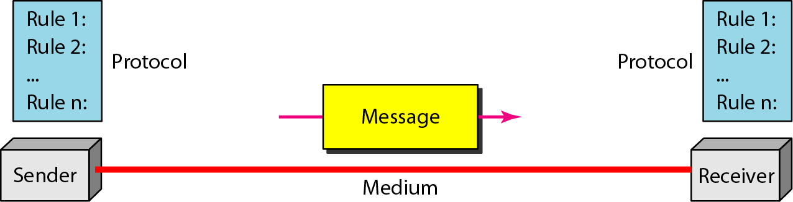
Function of protocol in network Protocol Hierarchies .
A protocol is a agreement between the communicating parties on how communication is to proceed.

Slide 6
Protocol Hierarchies (3)
Example information flow supporting virtual communication in layer 5.

Slide 7
Design Issues for the Layers.
Addressing or naming.
• Error Control.
• Flow Control---Congestion.
• Statistical Multiplexing.
• Routing.
• Scalable.
• QoS---real time.
• Reliability.
• Security.

Slide 8
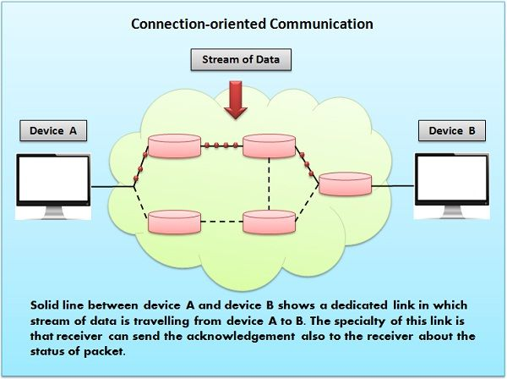
Connection-Oriented and Connectionless Services .
Connection-oriented service It is related to the telephone system. It includes connection establishment and connection termination. In a connection-oriented service, the Handshake method is used to establish the connection between sender and receiver.

Slide 9
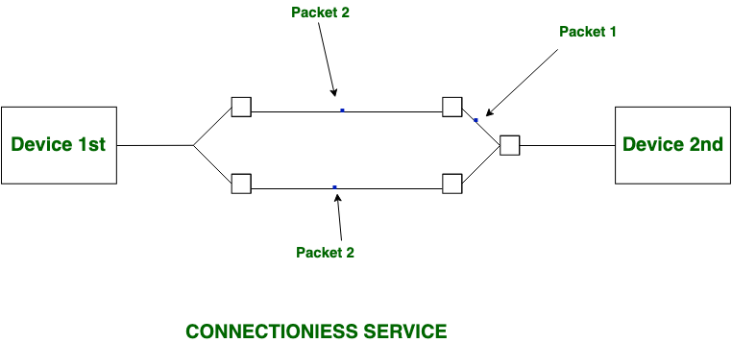
Connectionless Services .
Connection-less service is defined as the postal system which does not include any connection establishment and connection termination.
Connection-less Service does not give a guarantee of reliability. In this, Packets do not follow the same path to reach their destination.

Slide 10
Connection-Oriented and Connectionless Services. Six different types of service.

Slide 11
Five service primitives for implementing as connection-oriented service.

Slide 12
Service Primitives (2) Packet is sent in client server interaction connection oriented network.

Slide 13
Services to Protocols Relationship. The relationship between a service and a protocol.

Slide 14
Thanks

